Slide 1
PORT HOUSTON OVERVIEW
Sabeeta Bidasie-Singh, Director Business Equity

Slide 2
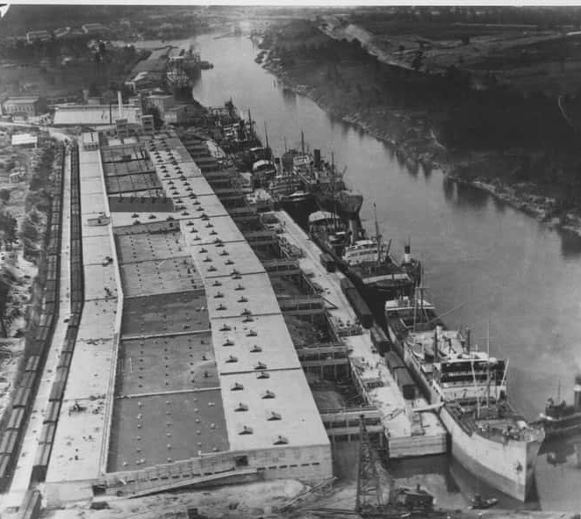
THE FOUNDATION
OF PROSPERITY
• Houston’s Ship Channel officially opened as a deep-water port in 1914
• At the time, the channel was 25-feet deep and 150-feet wide
Notes:
Let me give you a little history about the port. It officially opened as a deep-water port in 1914.
Back when the port had just opened, there was very little industry along the channel. It’s certainly changed a lot over the years!

Slide 3
ENGINE OF ECONOMIC
PROSPERITY
The Houston Ship Channel is a crucial economic engine
NO
CHANNEL
NO
JOBS
NO
PORT
NO
COMMERCE
NO
CARGO
Notes:
How things have changed with the Houston Ship Channel?
I love this saying: “No channel, no port; no port, no cargo; no cargo, no commerce; no commerce, no jobs.” That’s how important the Houston Ship Channel is today.

Slide 4
HOUSTON SHIP CHANNEL,
A FEDERAL WATERWAY
1.54
MILLION
JOBS IN TEXAS
3.37
MILLION
JOBS NATIONWIDE
$439
BILLION
ECONOMIC IMPACT IN TEXAS
$906
BILLION
ECONOMIC IMPACT ACROSS THE U.S.
Notes:
Let’s talk a little bit about why the Houston Ship Channel is so important. The Houston Ship Channel is 52 miles long, supports more than 200 facilities located alongside it, and is the busiest waterway in the world.
The Houston Ship Channel and the industries along it support nearly 1.54 million jobs in Texas and 3.37 million jobs nationwide, and economic activity totaling $439 billion in Texas, which is 19% percent of Texas’ total gross domestic product (GDP).
This port has an economic impact of nearly $906 billion across the United States.

Slide 5
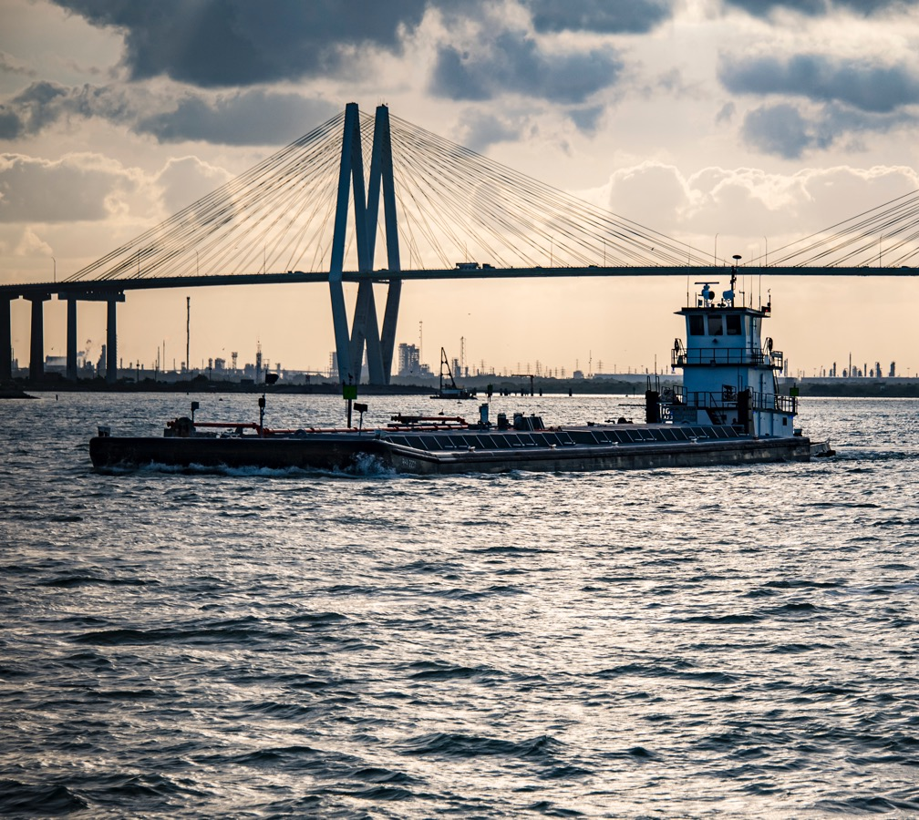
HOUSTON’S PORT
IS NUMBER ONE
• #1 in exports of Propane and Ethane
• #1 in exports of Butanes
• #1 in production and exports of Ethylene, Propylene, Butylene and Butadiene
• #1 export state
• #1 in exports of Petroleum and Petroleum Products
• #1 in resin exports with 60% market share
• #1 container port in the U.S. Gulf Coast
• #1 in deep water vessel traffic
#1
in waterborne
tonnage
Notes:
There’s been growth all along the channel, and that growth is expected to continue.
Houston’s port is ranked number 1 for waterborne tonnage. That’s huge. We also are number one for foreign waterborne tonnage and in number of vessel transits.
Companies along the ship channel have invested more than $50 billion in recent years, triggering increased polyethylene resin manufacturing, and those resins move across Port Houston’s docks to be exported overseas to be made into consumer goods.
From 2009 to 2019, international exports from the industries along the Houston Ship Channel grew 50% faster than U.S. waterborne export tonnage overall.
In fact, Texas is the number 1 export state and the greater Houston area is the number one export region.
Imports are growing too, as the population in Houston and Texas continues to expand and demand for e-commerce and household goods, building materials and food and beverage increases. That is attracting more and more distribution centers like those for big retailers like IKEA, Ross, and 5 Below.

Slide 6
SUPER PORT COMPLEX ON
A SCALE LIKE NO OTHER
Notes:
Houston is also number one in the nation for steel and handles 73% of all containers that come to the U.S. Gulf of Mexico.
In fact, we are the busiest U.S. port - with more than 8,300 deep draft ship calls annually, vessel traffic in our port is equivalent to the ports of Los Angeles, Long Beach, and NY/NJ combined.
Those ship calls translate into more than 20,000 transits in, out and within the port.
Add to it more than 200,000 barge moves each year and the Houston Ship Channel is the most active and productive economic engine in the country, serving the fastest growing population and state in the country.

Slide 7
HOUSTON SHIP CHANNEL
CARGO SECTORS 2023
15%
7%
3%
71%
4%
Liquid Bulk
Containerized
Project Cargo
Dry Bulk
General Cargo
Notes:
Liquid Bulk (71%), Containerized (15%), General Cargo (8%), Project Cargo (4%), Dry Bulk (3%)
Port Houston operates 2 container terminals and leases 6 general cargo terminals along the channel, but there are nearly 200 private companies along the channel as well.
The majority of the products moving through these private terminals is liquid bulk such as Oil, refined gasoline, and other chemical products making up about 74% of the total tonnage .

Slide 8
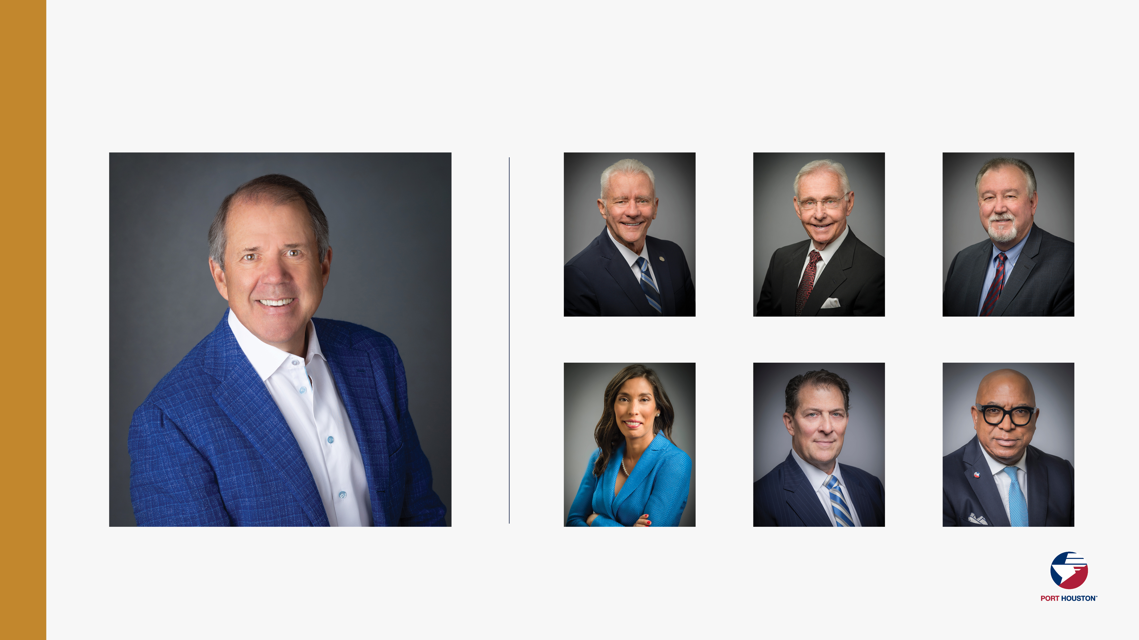
PORT COMMISSION
Dean E. Corgey
Commissioner
Clyde Fitzgerald
Commissioner
Stephen H. DonCarlos
Commissioner
Ric Campo
Chairman of the Port Commission
Wendy Montoya Cloonan
Commissioner
Alan Robb
Commissioner
Thomas Jones, Jr.
Commissioner
Notes:
So let’s talk about Port Houston. First, we are governed by a seven-member Commission, led by Chairman Ric Campo.

Slide 9
WHO WE ARE
We manage eight public terminals — including two container facilities we operate and six others for which we’re the landlord​
As the advocate and a strategic leader of the Houston Ship Channel, we support the more than 200 facilities and the neighboring communities along it by working with the federal government​
We facilitate vital commerce through the port that helps keep the local and state economy moving
Notes:
The Port of Houston Authority, known as Port Houston, is an Autonomous Subdivision of the State of Texas
Port Houston owns and operates the public wharves and terminals in the Houston Ship Channel. This includes two container terminals.
We are also the advocate and a strategic leader of the Houston Ship Channel. It is a federal waterway, and the government has designated Port Houston to care for and manage it.

Slide 10
OUR TERMINALS
Barbours
Cut
Jacintoport
& CARE
Turning
Basin
Bulk
Handling
Woodhouse
Grain Elevator
Bayport
Notes:
Port Houston operates, manages and oversees a total of 7 facilities.

Slide 11
PORT HOUSTON
CARGO SECTORS 2023
9%
2%
71%
18%
Containerized
Bulk Cargo
General Cargo (Steel)
General Cargo (Other)
Notes:
Updated slide on 04.25.24 post audit
Commodity sectors handled at Port Houston facilities are broken down into four major categories: General Cargo, Steel, Containers, & Dry Bulk.
As you can see containerized cargo makes up more than half of the total tonnage.

Slide 12
WHAT COMES IN A CONTAINER?
CONTAINERIZED FREIGHT: 2023
Port Houston Import Commodities | TEU
Machinery, Appliances & Electronics | 366,506
Retail Consumer Goods | 235,734
Hardware & Construction Materials | 206,647
Food & Drink | 188,121
Furniture | 176,581
Resins & Plastics | 133,817
Steel & Metals | 130,506
Automotive | 111,076
Chemicals & Minerals | 91,857
Apparel & Accessories | 64,284
Fabrics including Raw Cotton | 29,169
Other | 17,997
Port Houston Export Commodities | TEU
Resins & Plastics | 602,780
Chemicals & Minerals | 230,310
Automotive | 113,502
Apparel & Accessories | 98,714
Steel & Metals | 73,903
Machinery, Appliances & Electronics | 68,837
Food & Drink | 68,387
Fabrics including Raw Cotton | 33,612
Retail Consumer Goods | 19,972
Hardware & Construction Materials | 14,649
Furniture | 6,599
Other | 10,574
Note: Totals DO NOT include empty containers
Source: Journal of Commerce (PIERS), PH Research & Forecasting

Slide 13
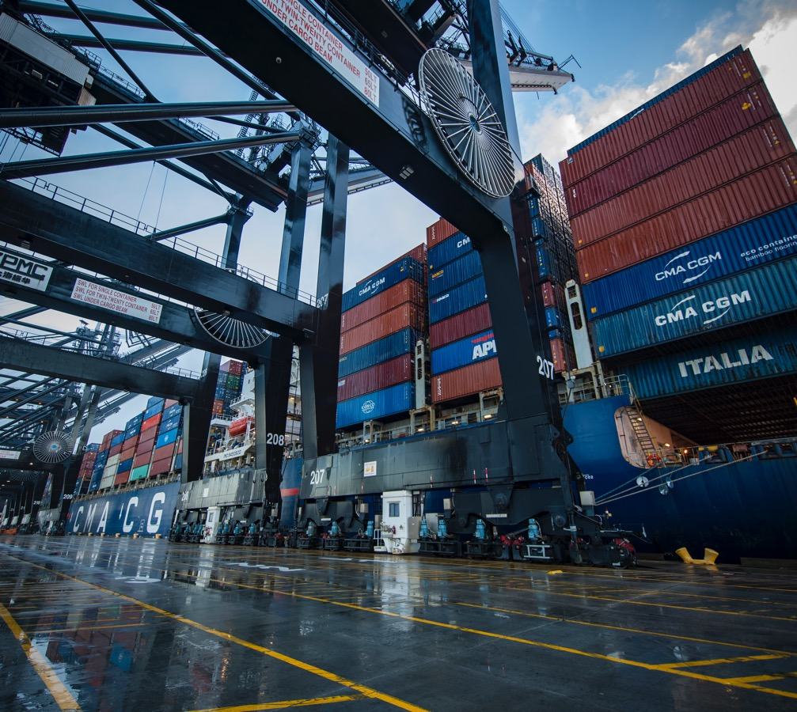
BIG GROWTH =
BIG OPPORTUNITIES
Investment of $1.26B landside in past 5 years
• Rehabilitation of wharves and yards
• Added container storage space
• Expansion of Barbours Cut entrance
• Improved traffic flow
• New Rubber Tire Gantry cranes
• 3 new STS cranes
With the investments in the Houston Ship Channel, including Project 11, we invested $1.95B between 2019 and 2023.
Notes:
Updated April 2024
BCT gate expansion – added 14 gates to bring the total to 29 entrance gates, plus we added a trouble ticket area, temporary security TWIC check lanes, and new scales. This work has improved the entrance traffic flow.
In July 2023 Port Houston received 3 new STS cranes. These will be able to facilitate working 15,000 TEU sized vessels we expect to call Houston once Project 11 is complete. The fleet now has 29 STS cranes and 116 RTGs.

Slide 14
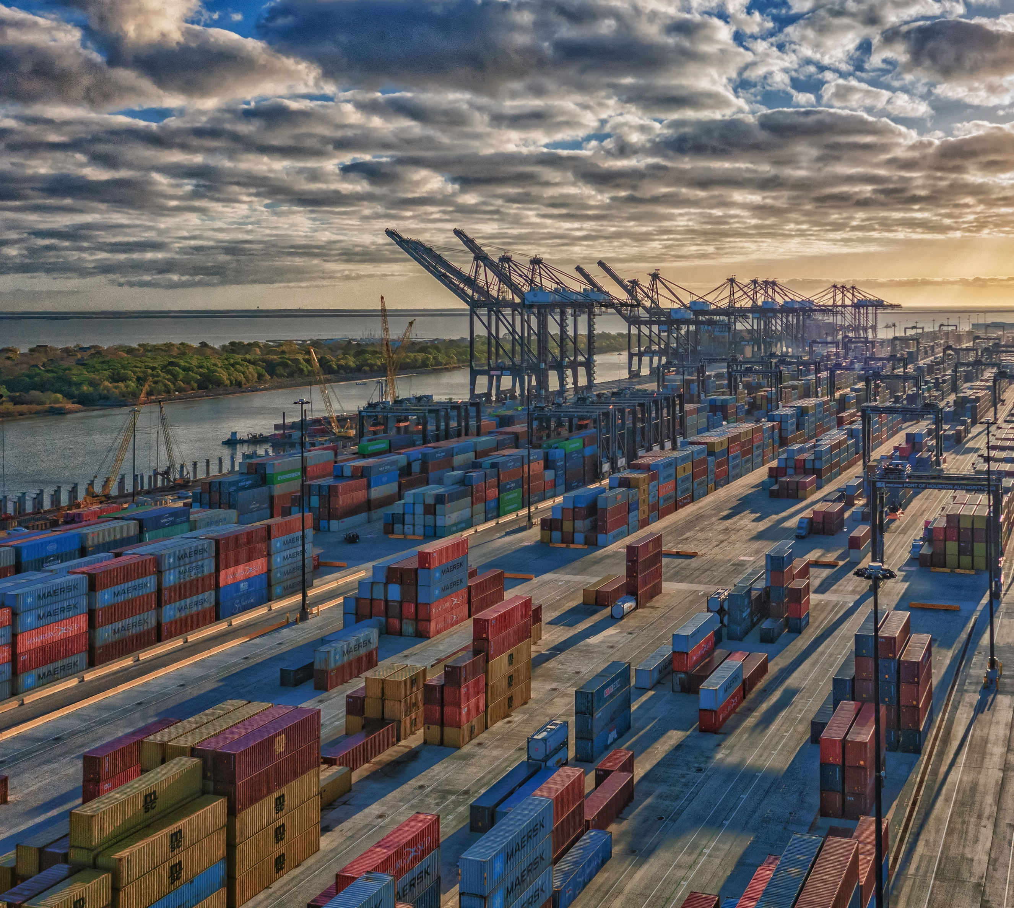
INVESTING FOR THE FUTURE
Increase capacity by investing $1.7 Billion landside over next 5 years
• Additional wharves at Bayport Container Terminal
• Ship to shore cranes
• Rubber Tire Gantry cranes
• Additional container yards
• Rehabilitation of wharves and yards
• Redevelopment of general cargo and breakbulk docks
Notes:
Updated April 2024
Equipment recap for 2024:
RTG Cranes
7 units arriving at BCT on 3/2.
6 units arriving at BPT first week in April.
6 units arriving at BPT late April/early May.
5 units arriving at BCT late November/ early December.
12 units to be ordered by August.
STS Cranes
3 units arriving at BPT late July/early August.
8 units (4 for BCT and 4 for BPT) to be ordered in August.

Slide 15
EXPANDING THE CHANNEL
Project 11
• Port Houston's most ambitious expansion initiative yet
The goal
• To widen much of the federal channel from 530 feet to 700 feet and make additional enhancements
$1 billion
• Public/private partnership project
Visit: www.expandthehoustonshipchannel.com

Slide 16
BUSINESS EQUITY
S/MWBE INITIATIVE
The Business Equity Department provides resources to small, minority- and woman-owned businesses (S/MWBE) seeking to participate in Port Houston procurements and contracts:
• Networking and mentorship
• Industry-specific programming and training opportunities
• Access to Port Houston procurements
• Awards and Commitments (since inception)
SB Program - $823.7M (2002)
- 24.2% YTD Performance
MWBE Program - $114.6M (July 2021)
- 16.5% YTD Performance
35%
SBE participation goal
30%
MWBE participation goal
Notes:
Initiative will reduce barriers to MBEs and WBEs who want to engage in business with Port Houston
Port Houston is working to identify and contact qualified S/MWBEs to meet our participation goals
Implemented race- and gender-neutral measures to ensure equal opportunities for all contractors and subcontractors
Port Houston is continuing to provide training, mentorship, networking and development assistance to all S/MWBEs

Slide 17
Opportunity U is a comprehensive training designed to support and assist local S/MWBE vendors. This initiative helps position these businesses to better compete for and participate in Port Houston procurements, potentially grow to become preferred contractors, and leverage other opportunities outside of Port Houston.
 | Program Overview / Topics:
Business Building Blocks / Financial Acumen | Project and Construction Management | Project Scopes and Projections / Capability Statements
Barbours Cut Tour Cohort Graduation | Safety and Risk Management / Cooperatives & Joint Ventures | Central Maintenance & Environmental Affairs
Responding to the RFP and Submitting a Sample Proposal | Legal & Operations | Procurement Team / Pricing Your Project

Slide 18
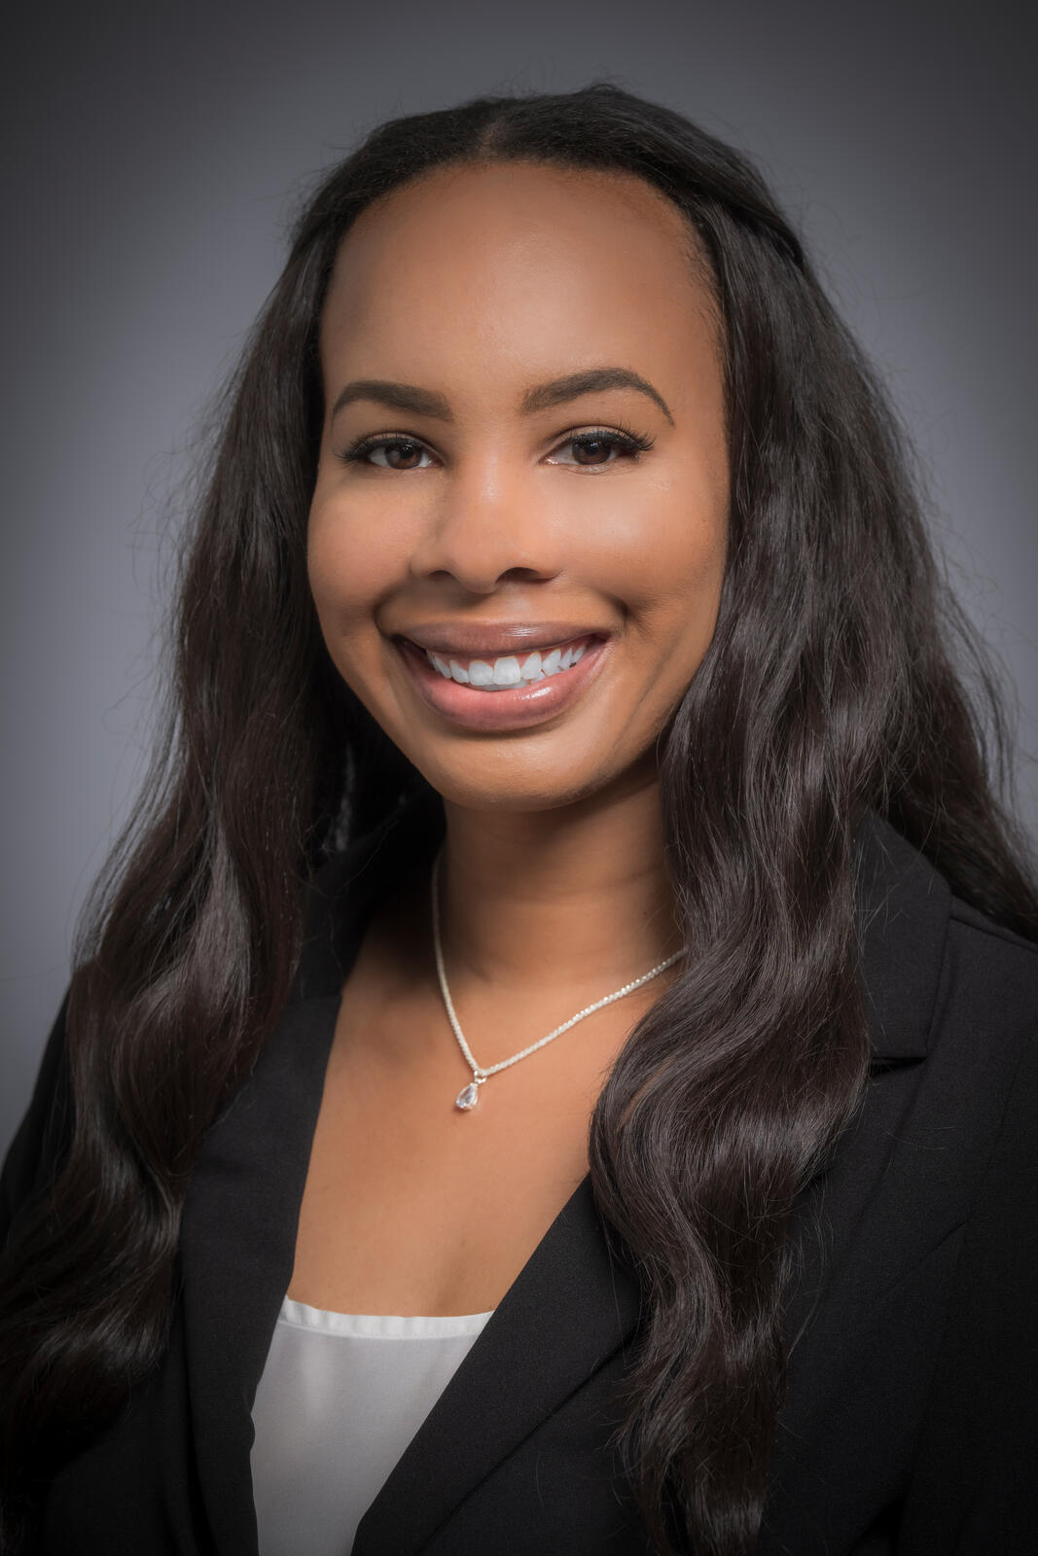
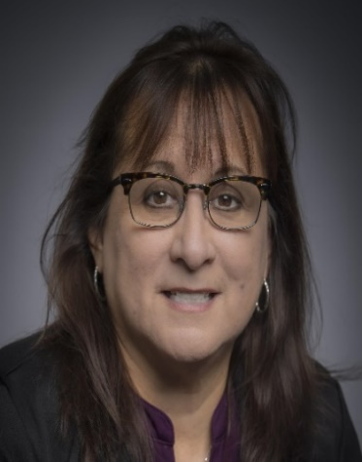
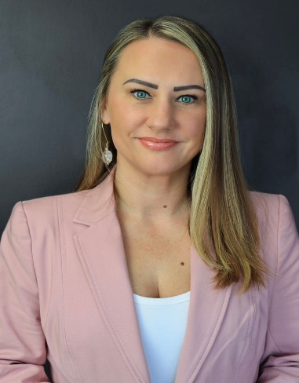
BUSINESS EQUITY DIVISION S/MWBE TEAM
Pedro Garcia
Outreach Manager
Brenda Ruiz
Supplier Diversity Manager
OPEN
Compliance Analyst II
Eduardo Mejia
Compliance Manager
Latoria Reid-Seymour
Training Coordinator
Dr. Sabeeta Bidasie-Singh
Director Business Equity
Consuelo Rodriguez
Administrator
Natasha Ainsworth
Compliance Analyst I
My Bui
Certification Generalist
Keondra Eaton
Coordinator
I

Slide 19
THANK YOU
PORT HOUSTON
@PortHOU
@port_houston
@Port_Houston
@Port Houston
Port Houston
Visit: www.porthouston.com

