Slide 1
U.S. Immigration Law Update:
How to Survive an Era of Immigration Bans & Quarantines Under the Biden Administration
Charles Foster, Chairman

Slide 2
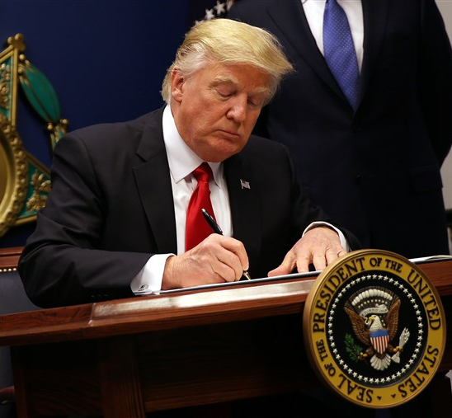
Impact of President Trump’s Ban on Employment Based Immigration and Nonimmigrant Work Visas
President Trump by Proclamation 10014 of April 22, 2020 banned issuance of employment-based immigrant visas.
President Trump Proclamation 10052 of June 22, 2020 banned issuance of H-1B, H-2B and L-1 immigrant work visas.
June 22, 2020 Proclamation extended such bans through December 31, 2020.
Such bans were based upon the adverse impact of the COVID-19 pandemic on the U.S. economy and the rise in unemployment.

Slide 3
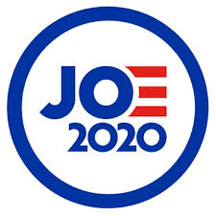
Impact of President Trump’s Ban on Employment Based Immigration and Nonimmigrant Work Visas
Under the terms of the bans, they do not apply within the U.S. to applications for change of nonimmigrant work status or to extend nonimmigrant work status or to applications for adjustment of status on Form I-485 for lawful permanent residency based on an employer’s approved I-140 petition.
The Trump Administration will likely continue such bans at least through January 20, 2021 inauguration and Senior White House Advisor Steve Miller almost certainly will recommend a longer extension.
Upon his inauguration on January 20, 2021, President Joe Biden and his Administration will almost certainly, by executive order, revoke many of President Trump’s executive orders on day one in different areas, particularly in immigration.
Notes:
- The Trump Administration will likely continue such bans at least through the January 20, 2021 inauguration and or very well some additional period of time. Senior White House advisor Steve Miller almost certainly will recommend same.

Slide 4
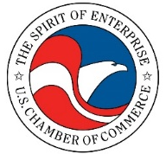
Impact of President Trump’s Ban on Employment Based Immigration and Nonimmigrant Work Visas
In the U.S. District Court case, National Association of Manufacturers et al., v. DHS, et al., the Trump Administration was enjoined from enforcing its ban on the issuance of temporary work visas, but such decision was restricted to the membership of the petitioning parties, being:
The National Association of Manufactures
The U.S. Chamber of Commerce
The National Retail Federation
Tech Net
Intrax, Inc.
Notes:
- The Trump Administration will likely continue such bans at least through the January 20, 2021 inauguration and or very well some additional period of time. Senior White House advisor Steve Miller almost certainly will recommend same.

Slide 5
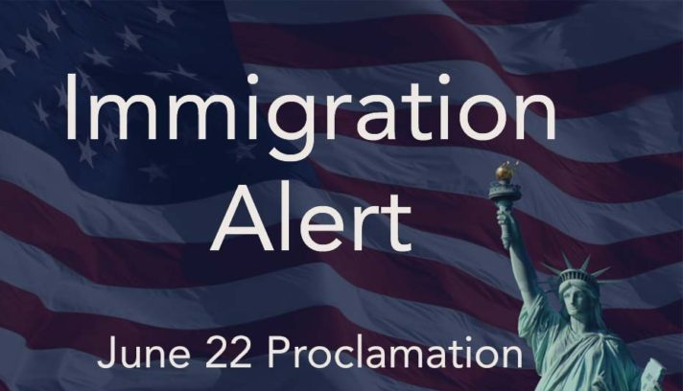
National Interest Exemptions to President Trump’s Proclamation Bans & Regional COVID-19 Bans
To qualify for a National Interest Exemption to President Trump’s June 22nd Proclamation 10052, each consulate post guidelines should be consulted.
Routine visa services on a post-by-post basis should resume soon, but it’s not yet possible to provide a date when each consular post will resume specific services.
Applicants from critical infrastructure sectors including chemical, energy, public health, and IT will be considered.

Slide 6
National Interest Exemptions to President Trump’s Proclamation Bans & Regional COVID-19 Bans
Pertinent factors include salary, credentials and contribution to critical infrastructure needs.
The National Interest Exemption will cover both the visa ban as well as the COVID-19 quarantine ban.

Slide 7
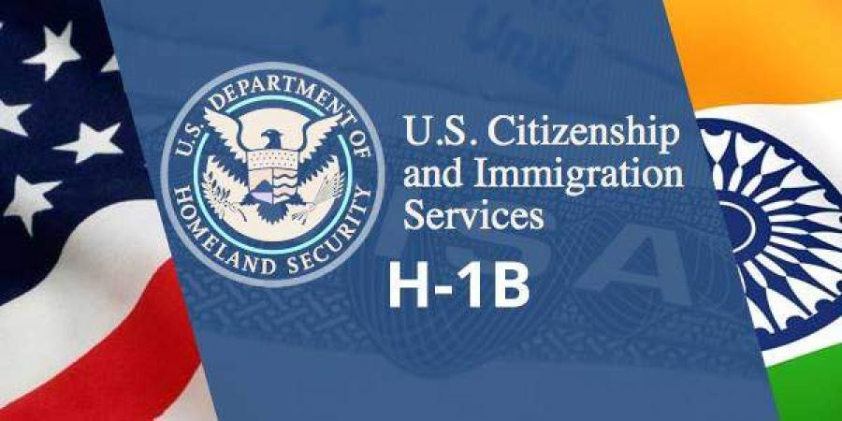
Significant Regulatory Restrictions on H-1B Specialty Occupation Visas
Historically, the H-1B work visa has been the primary route by which Indian and other foreign nationals could seek lawful permanent residency in the United States through employment.
Graduates of U.S. universities particularly with advanced degrees could remain in the U.S. following their Optional Practical Training by employers qualifying them for up to six years of authorized work status under the H-1B visa classification.

Slide 8
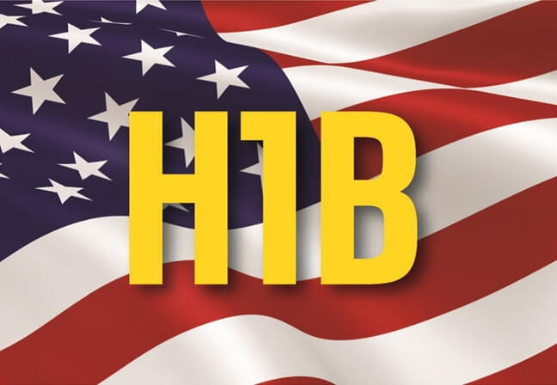
Significant Regulatory Restrictions on H-1B Specialty Occupation Visas
But given significant backlogs under the quota for lawful permanent residency in the employment-based classification, the 2000 American Competitiveness in the 21st Century Act allowed for extensions of H-1B status for additional 12 months increments.
But only if a bona fide employer files at least one year before H-1B expiration an application for labor certification or permanent employment certification (PERM) or otherwise an I-140 immigrant visa petition.
Upon approval of an immigrant visa petition on Form I-140, the H-1B status can be extended in three-year increments at a time.

Slide 9
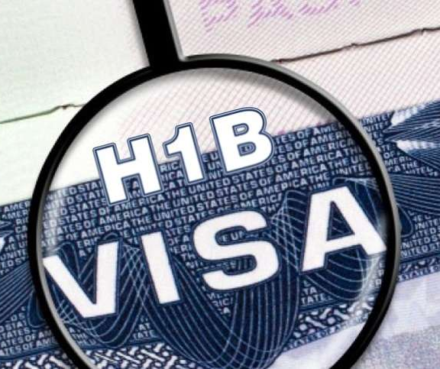
Significant Regulatory Restrictions on H-1B Specialty Occupation Visas
Under ImmaAct90, with 65,000 H-1B visa numbers a year, plus an additional 20,000 for graduates of U.S. universities with an advance degree, and many petitions filed annually in excess of 200,000, the H-1B program has become a de facto lottery.
The Trump Administration has proposed a series of H-1B regulatory changes that would defeat the very purpose of the H-1B visa classification as the primary route to obtaining lawful permanent residency.

Slide 10
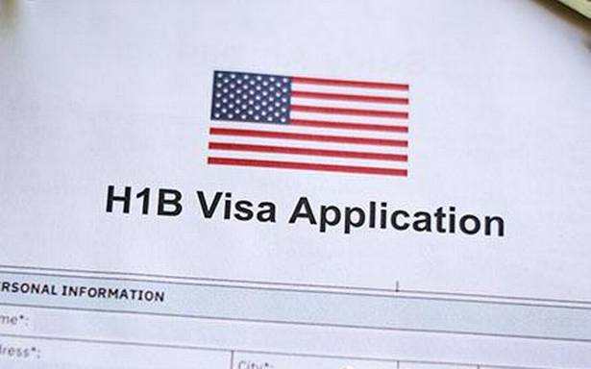
Significant Regulatory Restrictions on H-1B Specialty Occupation Visas
On October 8, 2020, the Trump Administration published its “Interim Final Rule” effective immediately and redefining of the meaning of “specialty occupation” (requires bachelor’s degree or equivalent to be ‘always’ an occupational requirements in the industry and ‘directly related’ to the specialty occupation) and limited an H-1B visa validity to a maximum of one year for workers placed at third party worksites and most significantly revised wage level methodologies for both H-1B and PERM.

Slide 11
Significant Regulatory Restrictions on H-1B Specialty Occupation Visas
The new regulation uses the terms “arithmetic mean” instead of “weighted averages” and changes the formula used to calculate the four wage levels of OES wage data with Level 1 going from 17 percentile to 45 percentile and Level 2 going from 34 percentile to 62 percentile.
Purdue University, other universities and plaintiffs filed on October 19, 2020 in U.S. District Court, Purdue University v. Eugene Scalia to challenge the Interim Final Rule prevailing wage determination as DHS did not follow notice and comment rule making requirements.
On November 2, 2020, U.S. Citizenship and Immigration Services (USCIS) published a proposed rule that dramatically alters the way in which H-1B registration are selected for the annual H-1B statutory cap replacing the current random selection process with one which would prioritize the selection of H-1B registrations based on employers who pay the highest wages.

Slide 12
Significant Regulatory Restrictions on H-1B Specialty Occupation Visas
If implemented, this rule would dramatically reduce access to the H-1B visa program for early-career professionals and no individuals paid at a Level 1 wage and very few paid at a Level 2 wage would be selected to file an H-1B petition, negatively impacting a wide range of employers, including the healthcare and technology industries.
Given the fact that the regulatory proposals have been subject to one or more temporary restraining orders, it is possible that the Biden Administration’s Department of Justice will no longer defend such regulations at a trial or on appeal and they may not go into effect.
However, it is likely that the Biden Administration will want to review the H-1B program and will support more modest modifications to protect the U.S. workforce.

Slide 13
Impact of COVID-19 on Entry into the U.S.
Visa applicants abroad are subject to the following Presidential COVID-19 quarantine proclamations if physically present in the following countries:
#9984 travel from China – 1/31/2020
#9992 travel from Iran – 2/29/2020
#9993 travel from Schengen countries – 3/11/2020
#9994 travel from Ireland and UK – 3/14/2020
#9994 travel from Brazil – 5/24/2020

Slide 14
Impact of COVID-19 on Entry into the U.S.
If NIE waiver has been submitted to the appropriate Consulate without response, after 14 days the applicant may submit the requests through the Houston Field Office (HFO)’s intended Port of Entry (POE) or other POE office with jurisdiction over the intendant port of arrival.
The applicant who lives outside of U.S. must show proof of a significant business or professional obligation that can’t be performed by other workers currently in the U.S.
HFO or other ports of entry will also consider directly requests for emergency or humanitarian issues with viable supporting documentation.

Slide 15
Impact of COVID-19 on Entry into the U.S.
Applicants who regularly reside in the U.S. on H, L, or E nonimmigrant work visas must show that their departure from U.S. was for significant business or professional obligations that couldn’t be performed by others outside of the U.S.
The waiver must be first submitted through the appropriate American consulate for at least 30 days before requesting the HFO POE or other POE to consider same.
14-day quarantine in a third other “third country” is a viable option.

Slide 16
Long-term Options for Lawful Permanent Residency for Indian Nationals
Unless one has an immediate relative who is a U.S. citizen or other close family citizen or LPR relatives, the traditional route to obtain lawful permanent residency has been through employment based upon employer obtaining PERM.
However, given the large number of Indian nationals who have sought permanent residency, under the 3rd preference for individuals with a bachelor’s degree these are numbers only available to those individuals whose PERM application was filed by March 20, 2015 per the December Visa Bulletin, which advances less than 12 months a year.
Under the 2nd preference for individuals with at least a Master’s degree, visa numbers are available only for those individuals whose petition was filed by October 1, 2015 per the December Visa Bulletin, which also advances less than 12 months a year.

Slide 17
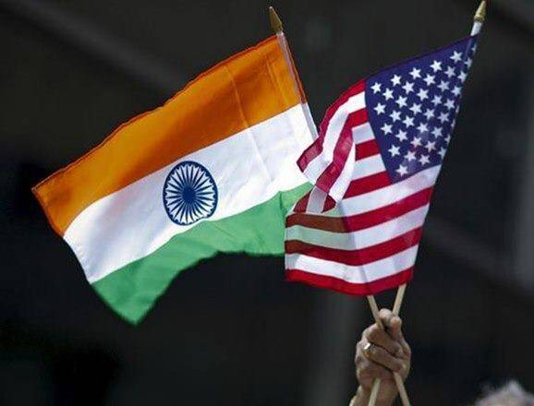
Long-term Options for Lawful Permanent Residency for Indian Nationals
While Congress may enact legislation that will benefit Indian nationals by removing the 7% per-country cap on all nations and the U.S. House of Representatives passed HR 1312 Fairness for High Skilled Immigration Act by a vote of 389 to 12, the U.S. Senate failed to pass S. 386 introduced by Senators Kamala Harris and Mike Lee.
Other than family and employment, the only other viable option would be through the EB-5 investor program which today requires a minimum $900,000 investment.
More EB-5 visa numbers are available due to unused FY 2020 Family Based visas and is current per the December 2020 visa bulletin.

Slide 18
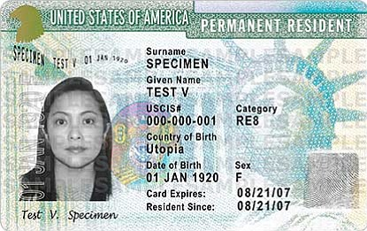
Conclusion
Legal immigration options will get better under the Biden Administration, although it’s impossible to predict when and how much.
It’s always better to remain in the U.S. to work out your immigration problems rather than traveling abroad given uncertainties at American consular posts.
It’s always better to start sooner rather than later.

Slide 19
Questions
Charles Foster
Chairman
Foster LLP
CFoster@FosterGlobal.com
713.335.3904

