Slide 2
Jagdip Ahluwalia
Executive Director, IACCGH

Slide 3
Upcoming Events:

Slide 4
Visit us at www.iaccgh.com
Follow us on:
https://www.facebook.com/jagdip.iaccgh
https://www.linkedin.com/company/indo-american-chamber-of-commerce-of-greater-houston/
https://twitter.com/JagdipAhluwalia

Slide 5
Any Questions?
Please type in your questions in the Q & A section, they will be answered after the presentation.

Slide 6
Tarush Anand
President, IACCGH

Slide 7
Nasrullah Khan
EVP and Chief Lending Officer, Wallis Bank

Slide 9
CARES ACT – PAYCHECK PROTECTION PROGRAM
NASRULLAH KHAN
EVP/CHIEF LENDING OFFICER
APRIL 9, 2020

Slide 10
PAYCHECK PROTECTION PROGRAM
The Paycheck Protection Program (PPP) is a loan to help small businesses to keep employees on the payroll. Funds can also be used to pay interest on mortgages, rent, and utilities.

Slide 11
WHO CAN APPLY FOR A PPP LOAN
SMALL BUSINESSES
Small businesses with less than 500 employees (including sole proprietorships, independent contractors and self-employed individuals), nonprofits, and veterans organizations.
BUSINESSES WITH MORE THAN 500 EMPLOYEES
Businesses with more than 500 employees in certain industries if they meet the SBA’s size standard for those particular industries.
HOSPITALITY AND FOOD INDUSTRIES
Hospitality and food industry businesses with more than one location, if store and location employs less than 500 workers.

Slide 12
INELIGIBLE FOR PPP LOAN
You are ineligible if -
Engaged in any illegal activity under any law
You are a household employer
Any owner of 20% or more of the applicant is incarcerated, on probation, on parole; presently subject to an indictment, criminal information, arraignment, or other means by which formal criminal charges are brought in any jurisdiction; or has been convicted of a felony within the last five years.
You, or any business owned or controlled by you or any of your owners, has ever obtained a direct or guaranteed loan from SBA or any other Federal agency that is currently delinquent or has defaulted within the last seven years and caused a loss to the government.

Slide 13
HOW MUCH CAN A BUSINESS BORROW?
Loans can be up to two months of your average monthly payroll costs from last year plus an additional 25% of that amount.
Amount is subject to a $10millon cap
Seasonal/new business: payroll costs will be capped at $100,000 annualized basis for each employee
Add the outstanding amount of any EIDL loan made between 1/31/2020 and 4/3/2020 less the amount of any “advance” under EIDL

Slide 14
LOAN TERMS
Interest Rate: 1.00% fixed rate
Payments deferred for 6 months, interest continues to accrue
No collateral required
Loan due in 2 years
No one can apply for more than one PPP loan

Slide 15
LOAN TERMS (CONTINUED)
Fully Forgiven*
Loan fully forgiven if funds are used for payroll costs, interest on mortgages, rent, and utilities (due to likely high subscription, at least 75% of the forgiven amount must be used for payroll).
Neither the government nor lenders will charge small businesses any fees

Slide 16
LOAN TERMS (CONTINUED)
Maintaining or Rehiring Employees
Forgiveness is based on the employer maintaining or quickly rehiring employees and maintaining salary levels.
Forgiveness will be reduced if full-time headcount declines, or if salaries and wages decrease.
*for full details on forgiveness terms, please visit www.sba.gov

Slide 17
PAYROLL COSTS INCLUDE
Salary, wages, commissions, or tips *
Employee benefits including costs for vacation, parental, family, medical, or sick leave; allowance for separation or dismissal; payments for provisions on group health care benefits including insurance premiums; and payment for any retirement benefit
State and local taxes assessed on compensation
For sole proprietor or independent contractor: wages, commissions, income, or net earning from self-employment *
*capped at $100,000 on an annualized basis for each employee

Slide 18
PAYROLL CALCULATION - SAMPLE 1
OPTION 1 - Companies open all of 2019 with no seasonal impacts | January-19 | February-19 | March-19 | April-19 | May-19 | June-19 | July-19 | August-19 | September-19 | October-19 | November-19 | December-19 | Average
Salary & Wages
Commissions
Payment of Cash Tips
Vacation Pay
Paid Parental, Family, Medical or Sick Leave
Allowance for Dismissal or Separation
Employer Payments for Group Health Care (including insurance premiums)
Employer Payment of any Retirement Benefit
Employer Payment of State or Local Tax assessed on compensation of Employees
Less Portion Salary / Wages for any individual in excess of $100,000 (on an annualized basis)
Less Salary / Wages for any individual whose primary residence is not the US
Total: | $0 | $0 | $0 | $0 | $0 | $0 | $0 | $0 | $0 | $0 | $0 | $0 | $0
 |  |  |  |  |  |  |  |  |  |  | Estimated Loan Amount: |  | $0

Slide 19
PAYROLL CALCULATION – SAMPLE 2
OPTION 2 - Seasonal Businesses | February-19 | March-19 | April-19 | May-19 | June-19 | Average
Salary & Wages
Commissions
Payment of Cash Tips
Vacation Pay
Paid Parental, Family, Medical or Sick Leave
Allowance for Dismissal or Separation
Employer Payments for Group Health Care (including insurance premiums)
Employer Payment of any Retirement Benefit
Employer Payment of State or Local Tax assessed on compensation of Employees
Less Portion Salary / Wages for any individual in excess of $100,000 (on an annualized basis)
Less Salary / Wages for any individual whose primary residence is not the US
Total: | $0 | $0 | $0 | $0 | $0 | $0
 |  |  |  | Estimated Loan Amount: |  | $0

Slide 20
PAYROLL CALCULATION – SAMPLE 3
OPTION 3 - New Businesses Opened Prior to 2/15/2020 but not open for 12 months | January-20 | February-20 | Average
Salary & Wages
Commissions
Payment of Cash Tips
Vacation Pay
Paid Parental, Family, Medical or Sick Leave
Allowance for Dismissal or Separation
Employer Payments for Group Health Care (including insurance premiums)
Employer Payment of any Retirement Benefit
Employer Payment of State or Local Tax assessed on compensation of Employees
Less Portion Salary / Wages for any individual in excess of $100,000 (on an annualized basis)
Less Salary / Wages for any individual whose primary residence is not the US
Total: | $0 | $0 | $0
 | Estimated Loan Amount: |  | $0

Slide 21
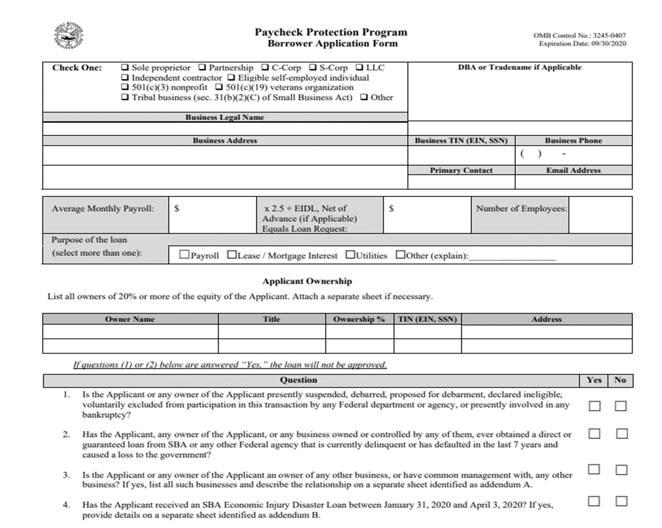

Slide 22
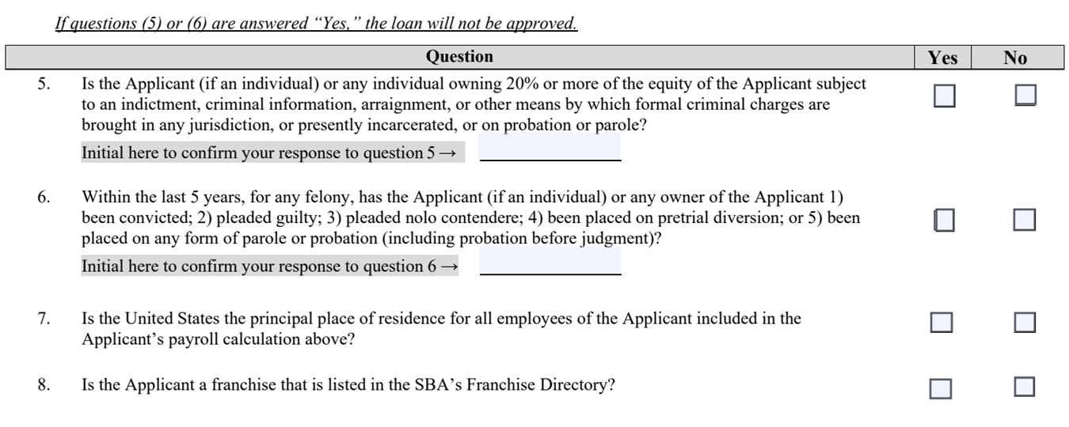

Slide 23
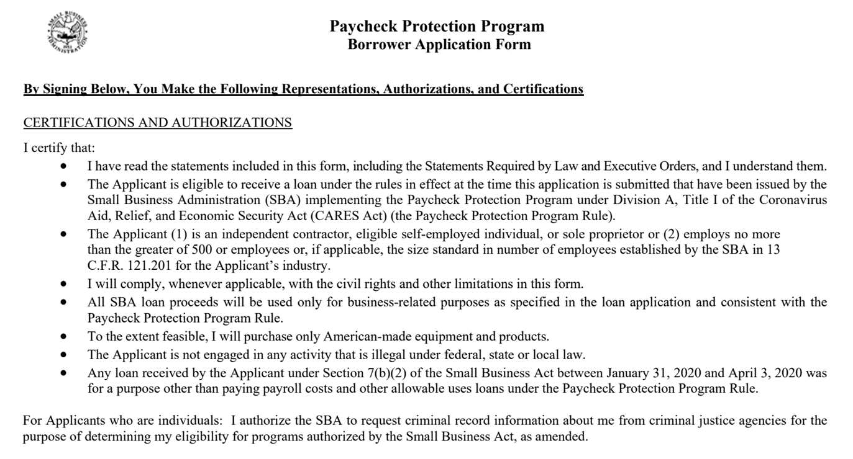

Slide 24
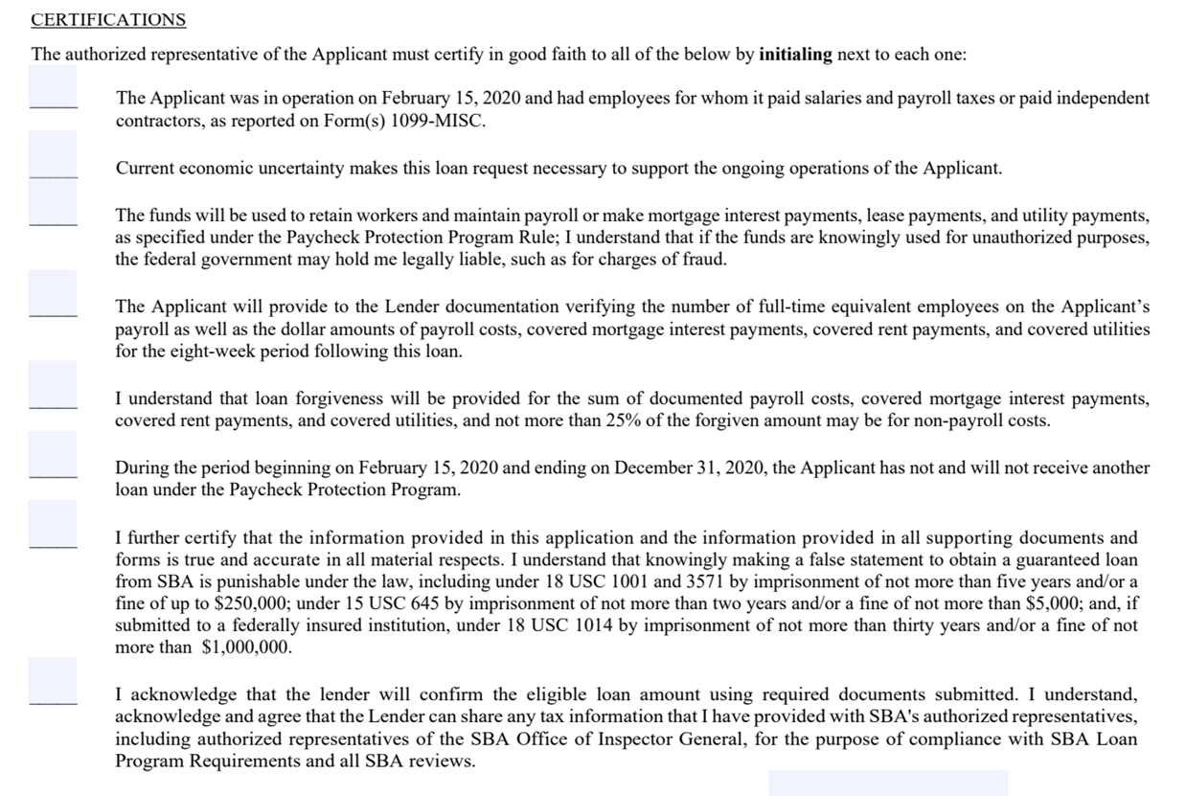

Slide 25
THE ACT EXPRESSLY EXCLUDES
Any compensation to an employee whose principal place of residence is outside of the US
Compensation of an individual employee in excess of an annual salary of $100,000 prorated as necessary
Federal Employment taxes imposed or withheld between 2/15/2020 and 6/30/2020 including employee’s and employer’s share of FICA and Railroad Retirement Act taxes, and income taxes required to be withheld from employees
Qualified sick and family leave wages for which a credit is allowed under section 7001 and 7003 of the Families First Coronavirus Response Act

Slide 26
WHEN TO APPLY
Starting April 3, 2020, small businesses and sole proprietorships can apply.
Starting April 10, 2020 independent contractors and self-employed individuals can apply.

Slide 27
HOW TO APPLY
Applicants will need to complete the PPP borrower application (SBA Form 2483) and provide payroll documentation to the lender.
Additional required documentation for the PPP must also be submitted
You are encouraged to apply as soon as possible because there is a funding cap.

Slide 28
Any Questions?
www.wallisbank.com
SBACARESAct@wallisbank.com

Slide 29
Any Questions?
Please type in your questions in the Q & A section.

Slide 30
Upcoming Events:

Slide 31
Visit us at www.iaccgh.com
Follow us on:
https://www.facebook.com/jagdip.iaccgh
https://www.linkedin.com/company/indo-american-chamber-of-commerce-of-greater-houston/
https://twitter.com/JagdipAhluwalia

